Slide 1

Social decision-making journal club
Thank Dr. Michael Hallquist, director of the DEPENd lab, for sharing this reading list!
The DEPENd lab studies personality functioning using decision neuroscience.
You are welcome to visit
our lab website for more
details!

Slide 2
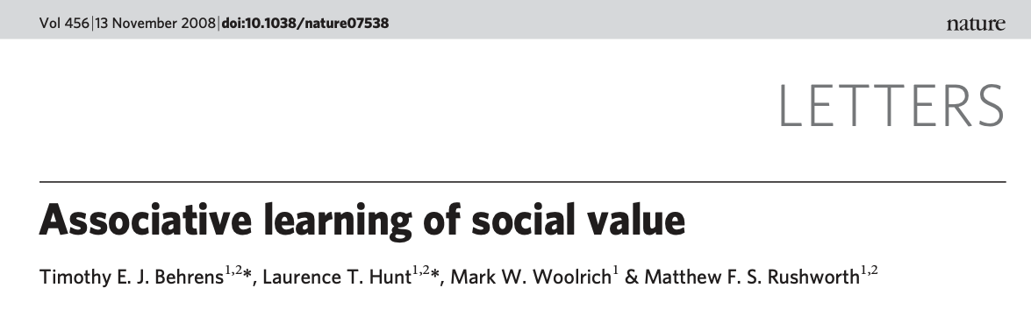
主讲人：马若璠 | Presenter: Ma, Ruofan
2022年1月10日 | Jan 14th, 2022
Find me on: Google Scholar | ResearchGate | Twitter @ma_ruofan

Slide 3
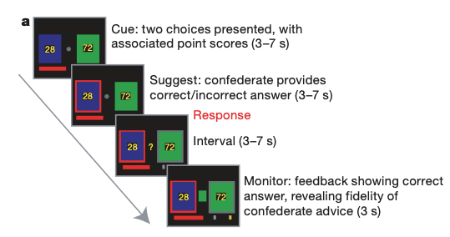
The chance of the rewarded colour being blue or green depended on the recent outcome history
Subject’s goal: maximize the number of points gained
Confederate's goal: keep the subject’s score within a pre-defined range
Red bar: Proportional to current score
Grey/gold target (not known to subject): reaching reward

Slide 4
Use of RL model
To estimate the probability of the reward (blue/green) and the probability of the confederate’s fidelity (correct/incorrect)
Reward prediction error: actual reward – expected value
Learning about the correct option (blue/green)
Confederate prediction error: actual – expected fidelity
Learning about the confederate’s fidelity
Learning rate: supposed to be faster in volatile environments and slower in stable environments

Slide 5
Bayesian probability tracking
r: underlying reward probability
Goal is to track the change of r over time
Question is how much the estimate of r should be updated when a new positive/negative outcome is observed
v: volatility; estimate of the expected rate of change of r

Slide 6
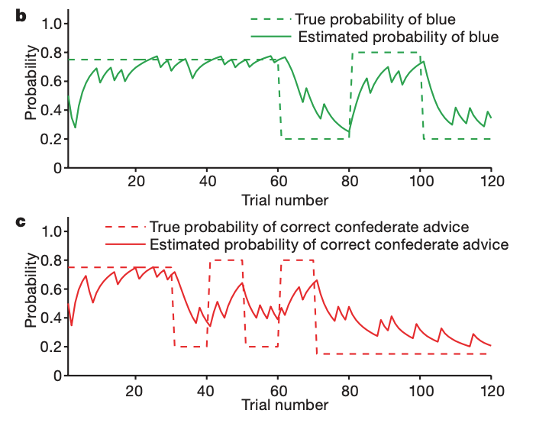
Notes:
Subjects underwent 120 trials in total (main figure 1b,c). During the first 60
trials, the reward history was stable, with a 75% probability of blue being correct.
During the next 60 trials, the reward history was volatile, switching between 80%
green correct and 80% blue correct every 20 trials.
Meanwhile, during the first 30
trials, the social advice given was stable, with 75% of suggestions being correct.
During the next 40 trials, the social advice given was volatile, switching between 80%
incorrect and 80% correct every 10 trials. During the final 50 trials, the advice given
was stable again, with 85% of suggestions being incorrect.
Solid lines show the model’s estimate of the probabilities.

Slide 7
Logistic regression
Did human behaviour match predictions from the RL model?
1 = blue; 0 = green

Slide 8
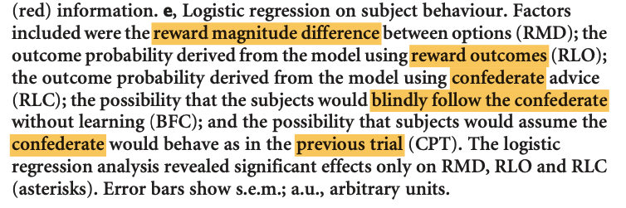
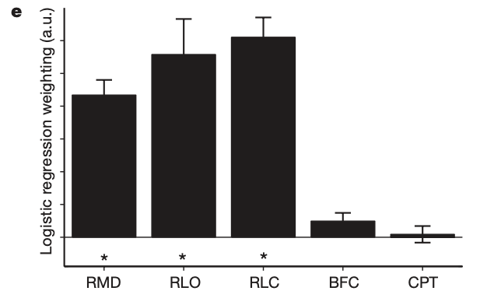
Notes:
No significant difference between the impact of RLO (reward) and RLC (social)

Slide 9
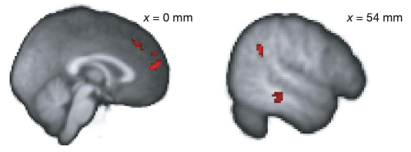
fMRI results | social valuation
BOLD activation in the dmPFC (dorsomedial prefrontal cortex), right MTG (middle temporal gyrus), and right STS/TPJ (superior temporal sulcus at the temporoparietal junction)
Correlates with social prediction error (confederate)

Slide 10
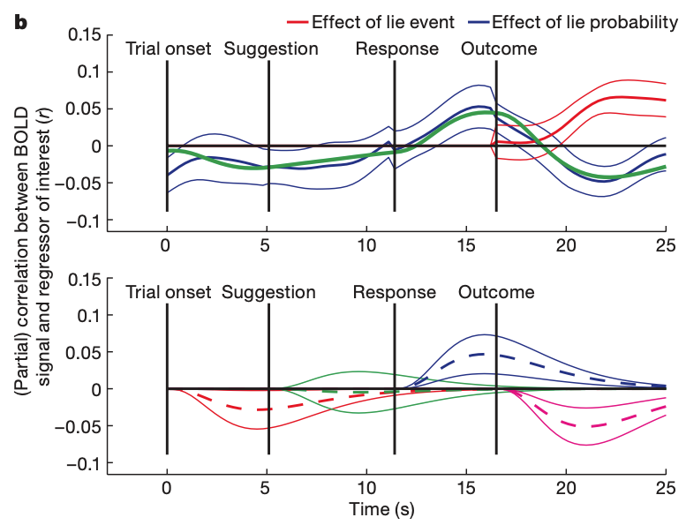
Notes:
Top: following the outcome, areas that encode prediction error correlate positively with the outcome and negatively with the predicted probability. Red, effect size of the confederate lie outcome (1 for lie, 0 for truth); blue, effect size of the predicted confederate lie probability. To perform inference, we fit a haemodynamic model in each subject to the time course of this effect (that is, to the blue line). The green line in the top panel shows the mean overall fit of this haemodynamic model (for comparison with the blue line).
Bottom: the effect of lie probability (blue line from top panel) is decomposed into a haemodynamic response function at each trial event (corresponding to the four colours in the bottom panel). Dashed and solid lines show mean responses +/- s.e.m.

Slide 11
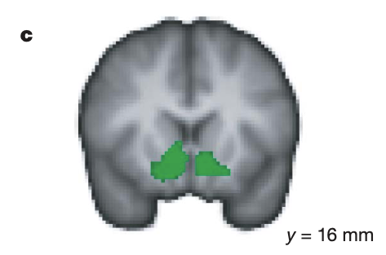
fMRI results | reward information
BOLD activation in the ventral striatum, vmPFC (ventromedial prefrontal cortex), ACC (anterior cingulate sulcus)
Correlates with reward prediction error (reward – expected reward)

Slide 12
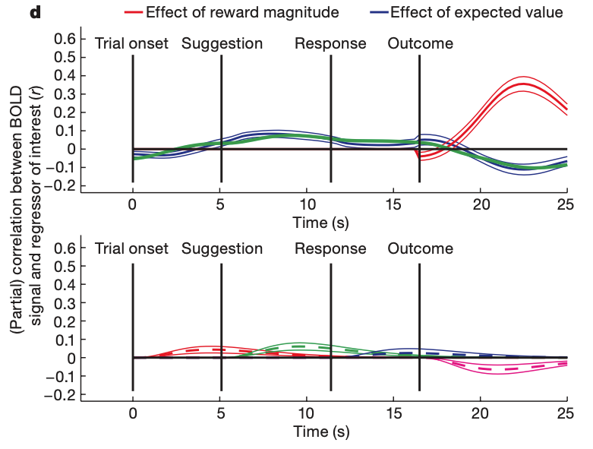
Notes:
the parameter estimate relating to the expected value of the trial (blue line)
after the outcome, the parameter estimate relating to the magnitude of these rewards (red line)
To test for prediction error coding, we again fit a haemodynamic model to the expectation parameter estimate (shown by the green line, for comparison with blue line)
Bottom panel: the time course showed a significant positive effect during the time of the decision (t22 5 3.32 (P , 0.002)), and a significant negative effect after the trial outcome
(t22 5 2.50 (P , 0.05)).

Slide 13
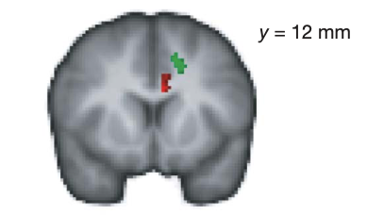
fMRI results | volatility of information
BOLD correlates of reward (green) and confederate (red) volatility
These regions predict the influence of volatility on behaviour
Green: ACCs (anterior cingulate sulcus)
Red: ACCg (ACC gyrus)
Notes:
BOLD signals in these two regions reflect the respective values of the same outcome for learning about the two different sources of information.

Slide 14
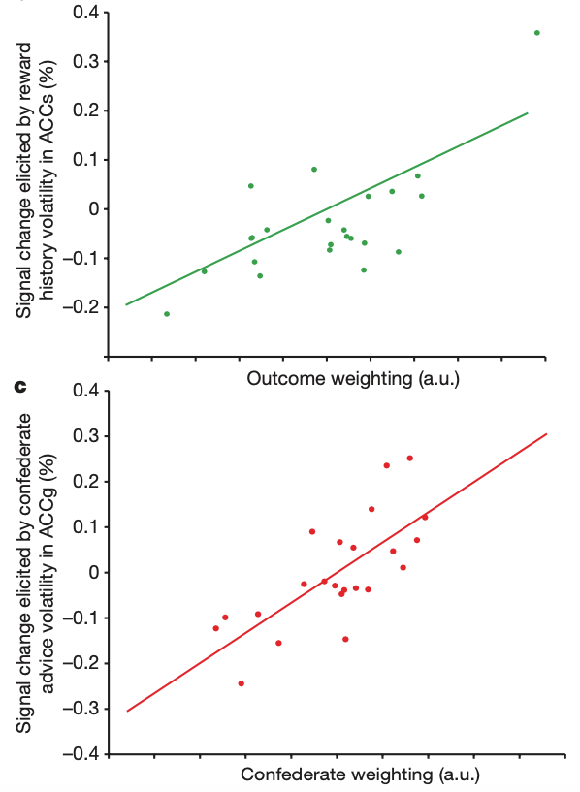
fMRI results | volatility of information
Notes:
b, Subjects with high BOLD signal changes in response to reward volatility in the ACCs are guided strongly by reward history information
c, Subjects with high BOLD signal changes in response to confederate advice volatility in the ACCg are guided strongly by social information

Slide 15
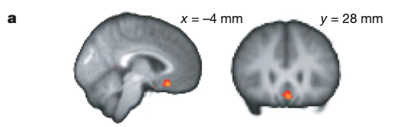
fMRI results | vmPFC
BOLD signal in the vmPFC (ventromedial prefrontal cortex) correlates with both
Probability of reward based on experience
Probability of reward based on confederate advice
Correlation varies across individuals (see next slide)

Slide 16
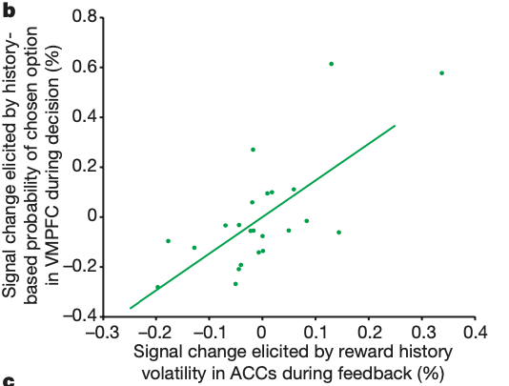
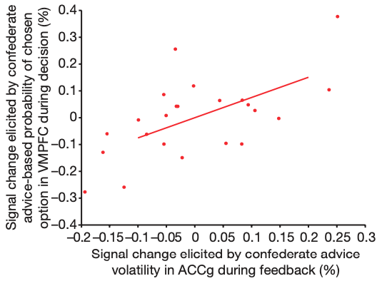
fMRI results | vmPFC
Notes:
The extent to which the VMPFC data reflected each source of information (at the time of the decision) was predicted by the ACCs/ACCg response to outcome/social volatility (at the time when the outcomes were witnessed) (Fig. 4b, c).

Slide 17
Discussion questions
The outcome in this study is a reward score. What if we use social reward?
Implications in psychiatry?

